Slide 1
Observations of SAT Scores 2001
Presented by Baurjan Safi
General Assembly. Class of DSI-5
July 2017

Slide 2
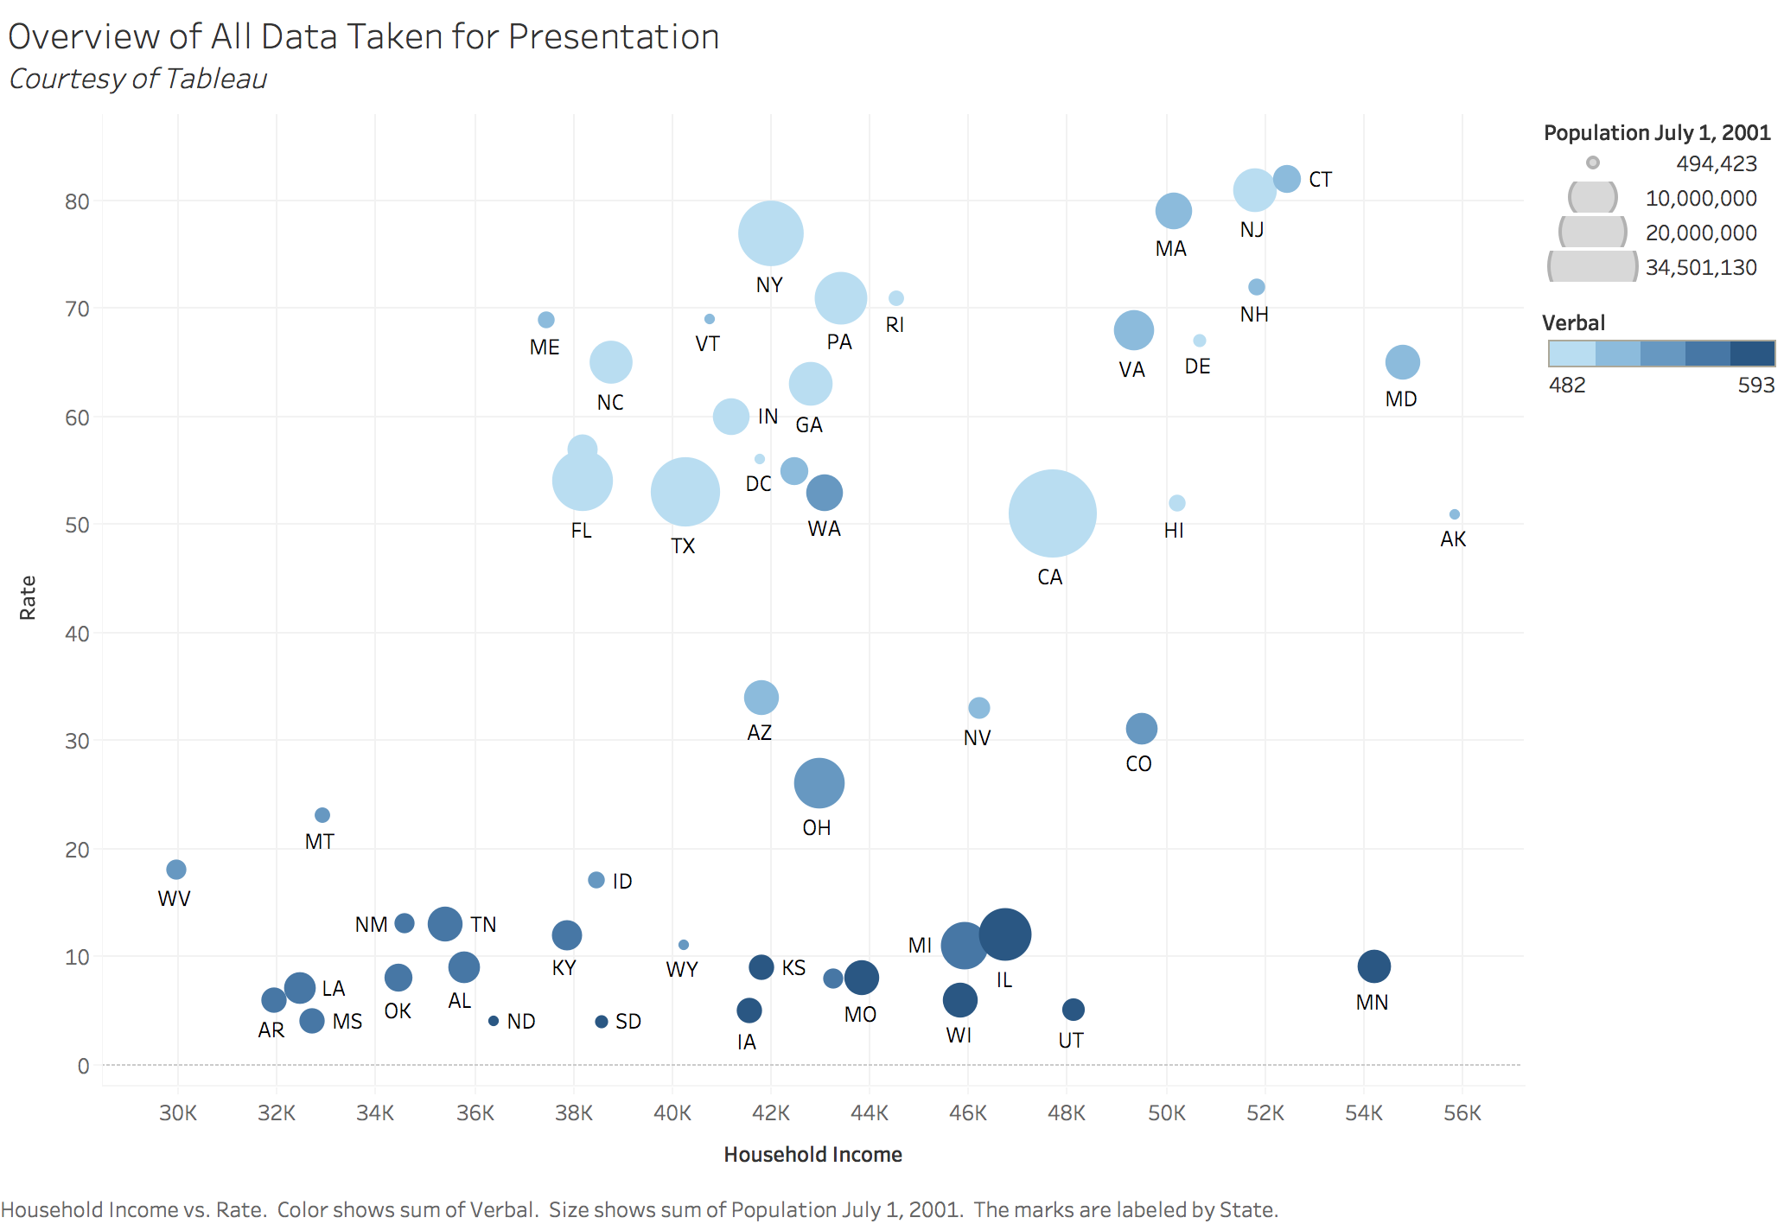
Overview of SAT Test results. Considered: Rate, Verbal Score, Household Income, Size of State

Slide 3
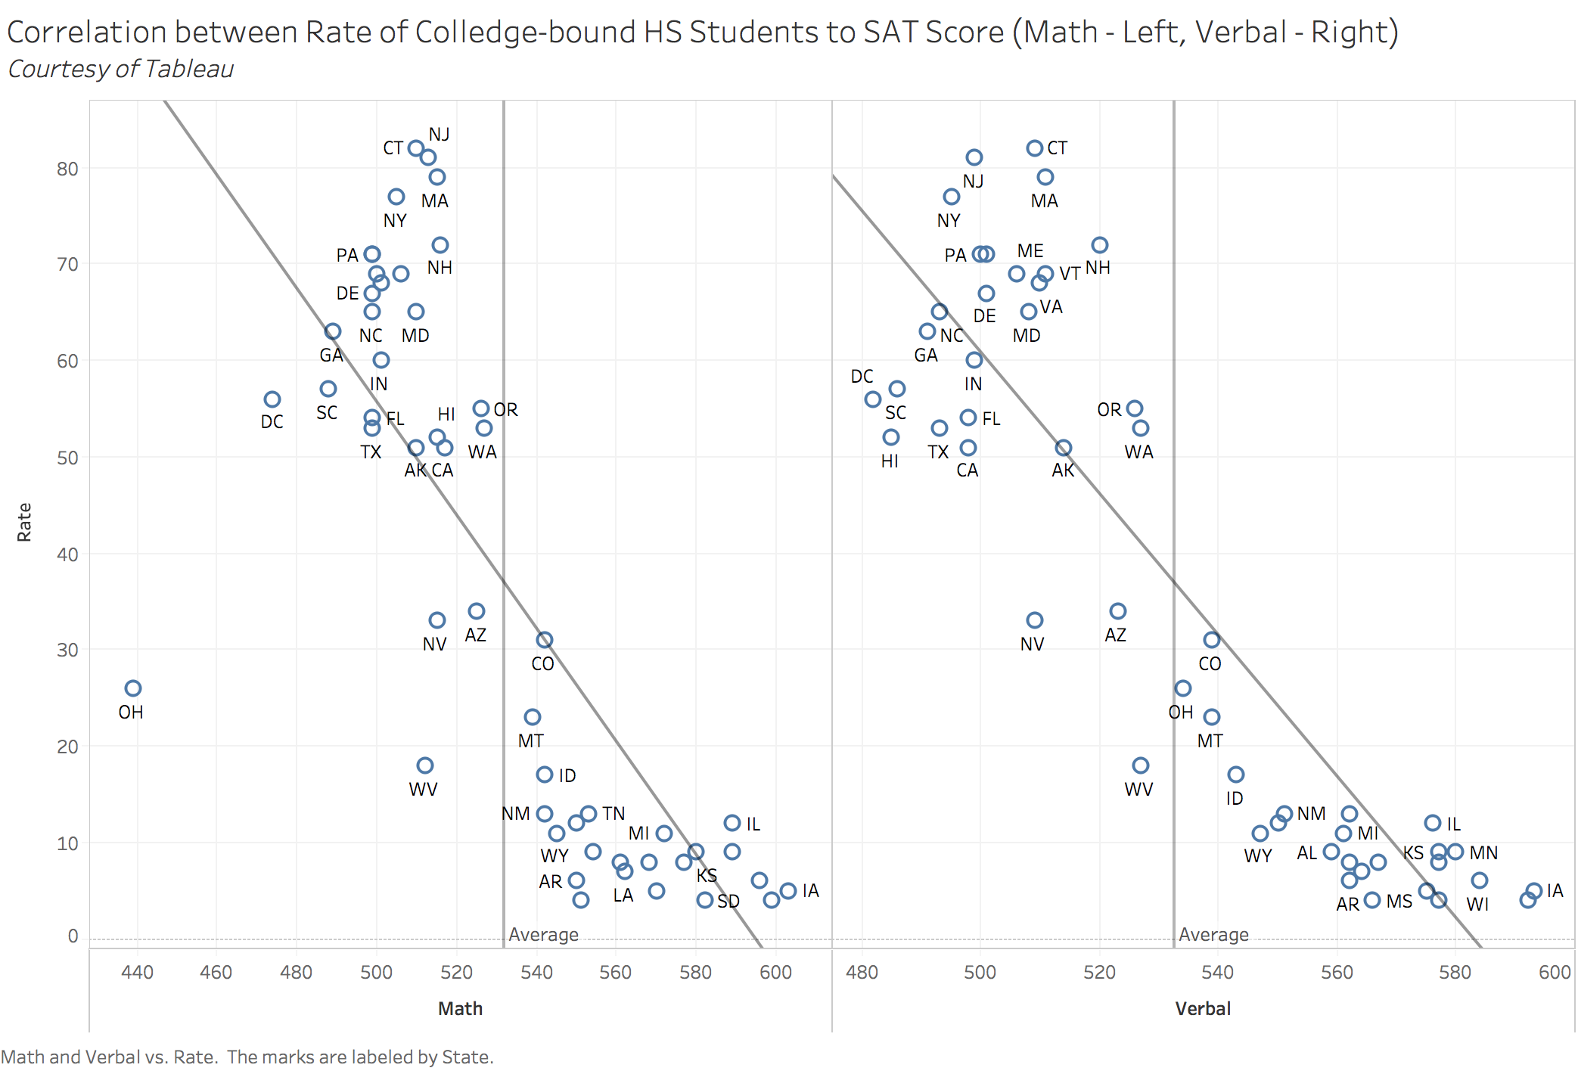
Quantity – Quality Controversy

Slide 4
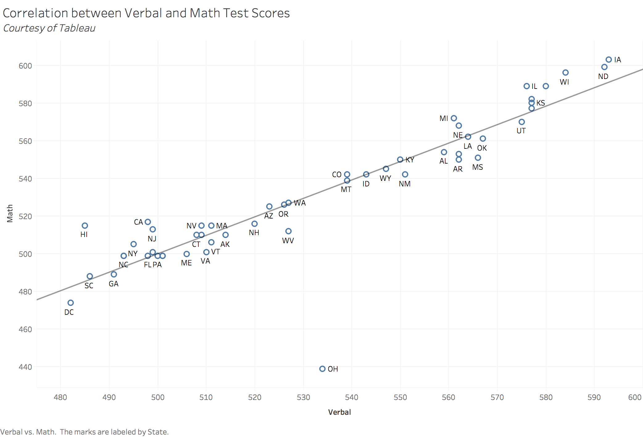
If you know math, you probably read better.

Slide 5
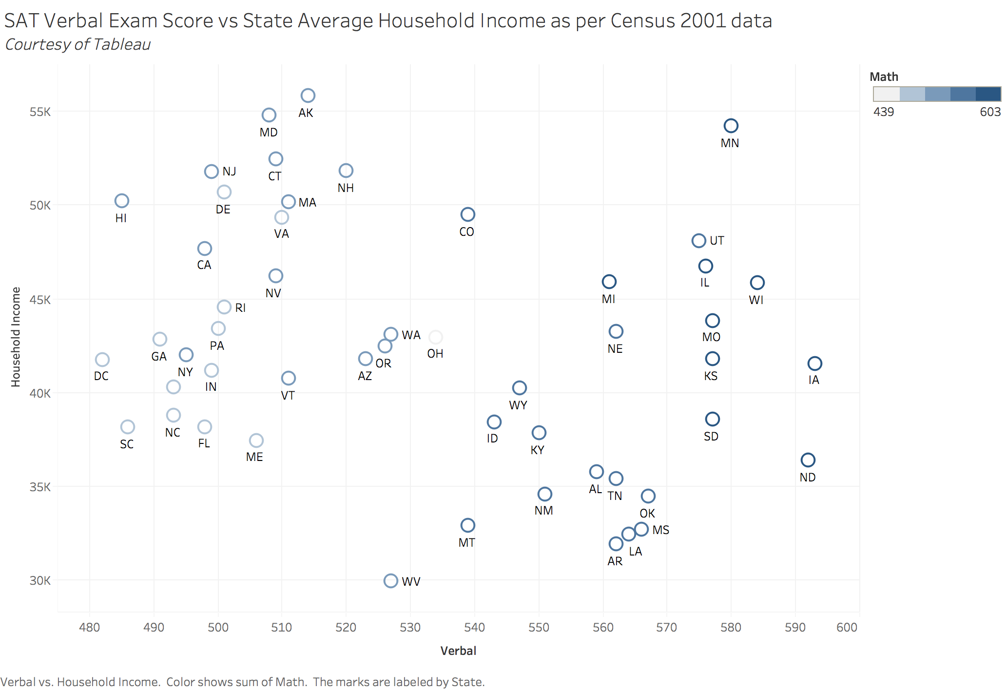
Average household income state-by-state does not define your results.

Slide 6
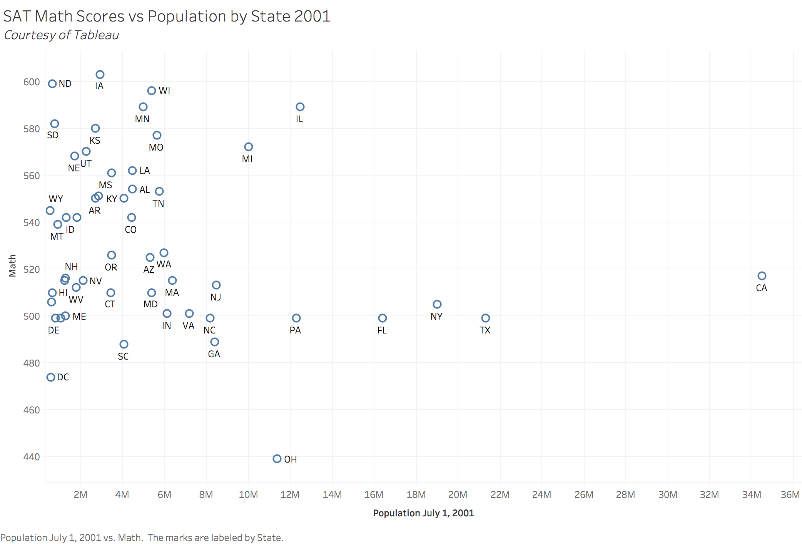
Does population affect the scores?

Slide 7
Thank you! Your questions are welcome!

